Slide 1
Applied Geographical Data Science (GE3259)
Dr. Sudatta Ray and Dr. Gopal Penny

Slide 2
Outline for today
Syllabus
What is data science?
Goals for the class
Introduction to R and RStudio

Slide 3
Syllabus
Please review the syllabus

Slide 4
What is data science?
Field of study that focuses on managing and analyzing data.
More commonly a practical approach to extract meaning and insights from data
Toolset including programming, statistics, data storage, visualization, and communication

Slide 5
Why do we need data science?
Data contains information about the world - we need to extract and interpret this information.
Data analysis is the basis for understanding cause-and-effect relationships for processes we cannot easily observe/test.
Large datasets carry vast amounts of information (The unreasonable effectiveness of data - Google Research)

Slide 6
Why is data science gaining influence?
Increasing computing power (i.e., Moore’s law)
More transistors on computer chips allows faster processing of bigger datasets
Increasing availability of data from (e.g.):
Consumers, social media users
Crowd sourcing
Artificial intelligence (AI)
Government agencies
Satellites
New algorithms for data processing
Faster and better processing of large datasets
New tools in AI. The “intelligence” of machines comes from data

Slide 7
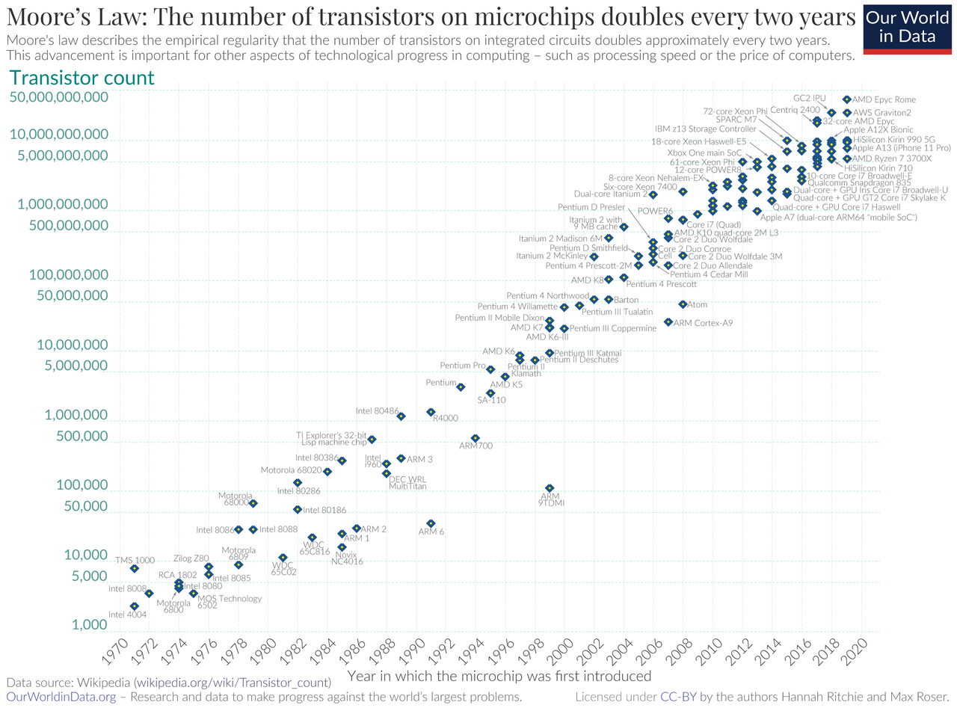

Slide 8
Data never sleeps
source: Domo

Slide 10
https://blog.adioma.com/5-personality-traits-infographic/

Slide 11
Your computer knows you better than your friends do, say researchers
The Guardian
“The researchers found that their software was able to predict a study participant’s personality more accurately than a work colleague by analysing just 10 [Facebook] likes.
“Inputting 70 Likes allowed it to obtain a truer picture of someone’s character than a friend or flatmate, while 150 likes out-performed a parent or sibling. It took 300 likes before the programme was able to judge character better than a spouse.”

Slide 12
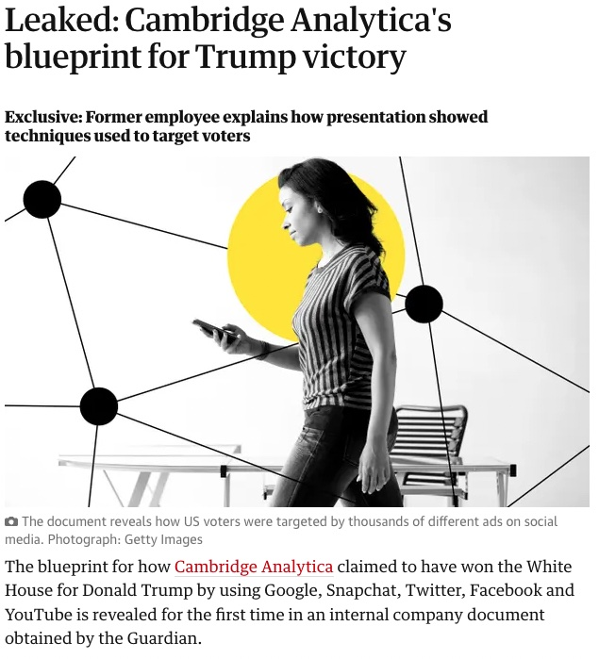
How could this be used?

Slide 13
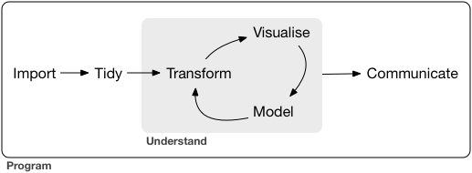
The data science process
Three stages:
Data wrangling (import & tidy)
Data analysis (transform, visualize, model)
Communication

Slide 14
Programming in R
Open source – all code fully available for free
Supported by package development – anyone can contribute packages!
Statistical computing and analysis
Full-time developers at RStudio have created an excellent environment for data science

Slide 15
Programming languages: python vs R
python and R are generally considered the most popular multi-purpose languages for programming

Slide 16
Challenges you will face
Conceptual
Programming
Math
Data wrangling
Language
R

Slide 17
Tips for success
Regular practice
Reviewing material
Completing assignments
3+ days per week
Discuss material with peers & instructors

Slide 18
Stuff

Slide 19
END OF SLIDES

Slide 20
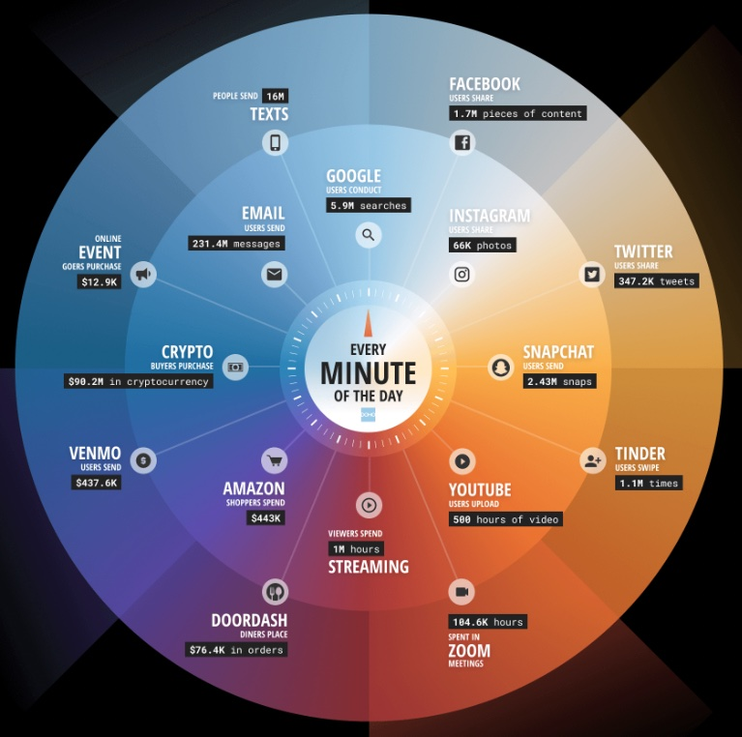

Slide 21
Data never sleeps (domo.com)

Slide 22
We generate massive amounts of data online
Too much data to view it all

Slide 23
Big data vs small data

Slide 24
Questions to ask
Has something increased? What is the biggest driver? How much data do I need? How did this variable change over time?
How will

Slide 25
What will we cover?
Syllabus

Slide 26
Why is it important?

Slide 27
Data science landscape
Why R?

Slide 28
Slide with R Output
summary(cars)
## speed dist ## Min. : 4.0 Min. : 2.00 ## 1st Qu.:12.0 1st Qu.: 26.00 ## Median :15.0 Median : 36.00 ## Mean :15.4 Mean : 42.98 ## 3rd Qu.:19.0 3rd Qu.: 56.00 ## Max. :25.0 Max. :120.00

Slide 29
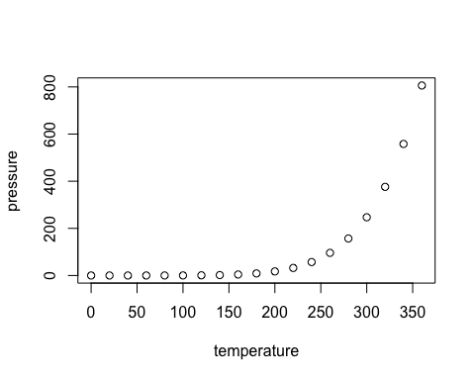
Slide with Plot

